Slide 1
The Research Rabbit Hole

Slide 2
Choose a primary source from our readings.

Slide 3
Choose a peer reviewed article that cites it.

Slide 4
Choose another peer reviewed article that cites your first article.

Slide 5
Six elements:
Complete the
primary source
worksheet (1)

Slide 6
Six elements:
Complete the
primary source
worksheet (1)
Complete the
scholarly article
worksheet for
your first article (2)

Slide 7
Six elements:
Complete the
primary source
worksheet (1)
Complete the
scholarly article
worksheet for
Article A (2)
Complete the
scholarly article
Worksheet for
Article B (3)

Slide 8
Six elements:
Complete the
primary source
worksheet (1)
Complete the
scholarly article
worksheet for
Article A (2)
Complete the
scholarly article
Worksheet for
Article B (3)

Slide 9

Six elements:
Complete the
primary source
worksheet (1)
Analyze relation
of primary and A (4)
Complete the
scholarly article
worksheet for
Article A (2)
Complete the
scholarly article
Worksheet for
Article B (3)

Slide 10
Six elements:
Complete the
primary source
worksheet (1)
Analyze relation
of primary and A (4)
Complete the
scholarly article
worksheet for
Article A (2)
Complete the
scholarly article
Worksheet for
Article B (3)
Analyze relation
of A and B (4)

Slide 11

Six elements:
Complete the
primary source
worksheet (1)
Analyze relation
of primary and A (4)
Complete the
scholarly article
worksheet for
Article A (2)
Your own concluding argument about relation of elements 1-5
(6)
Analyze relation
of A and B (4)
Complete the
scholarly article
Worksheet for
Article B (3)

Slide 12
Summary/Analysis/Argument

Slide 13
Getting started.

Slide 14
Research Rabbit Hole Clinic

Slide 15

1) Choose which primary text interests you.

Slide 16
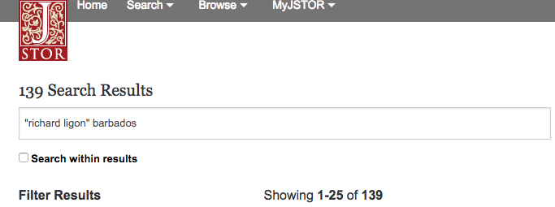
2) Search for that author/text on JSTOR/MLA Bibliography/Project MUSE, etc

Slide 17
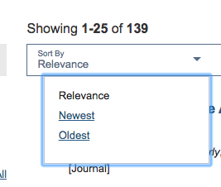
3) Look through the results
(You may want to sort results by date. At least one of your articles needs to be no more than 20 years old.)

Slide 18
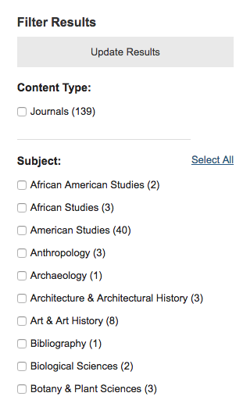
3b) Look through the results
(You may want to filter results.)

Slide 19
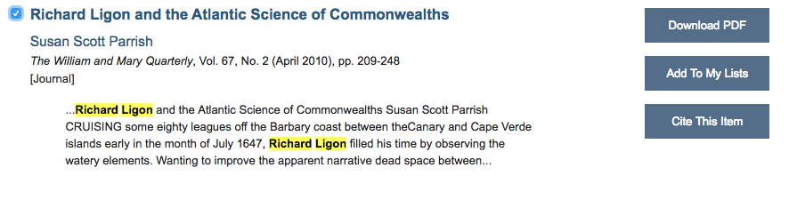
4) Identify a promising article, download it and skim it.

Slide 20

(This stage involves trial and error.)

Slide 21
5) How to build your centipede
One way
  Choose Article B/find article A/find primary.
Another way
  Choose primary/find article A/find article B.
Or even:
  Choose primary/find article B/find article A.

Slide 22
6) Choosing a second article
With the 2010 Parrish article, we could either a)find an article that Parrish cites in her essay on Ligon, or
b) find an article that cites Parrish’s essay.

Slide 23

How would you find an article that Parrish cites?
Read the article / read the article’s notes.

Slide 24
Ok but what if I want to find an article that cites Parrish’s essay.?
JSTOR?
  (A three year moving wall, so nothing after 2023 will be there)
MLA International Bibliography (focused on literature
Ask a librarian!
Also Google Scholar

Slide 25
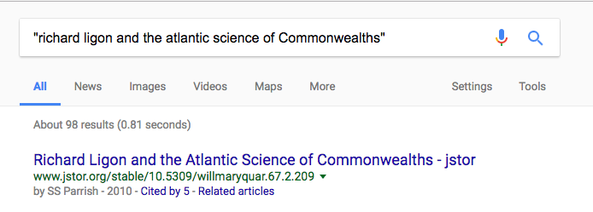
Google Scholar

Slide 26
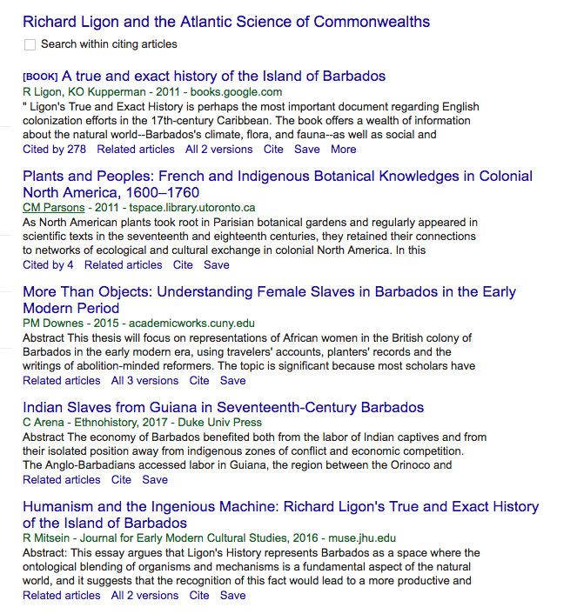
Click on “cited by” link
Five results

Slide 27
7) Back to kissing frogs, but only five of them.

Slide 28
8) We have a winner!
Rebekah Mitsein. "Humanism and the Ingenious Machine: Richard Ligon’s True and Exact History of the Island of Barbados." Journal for Early Modern Cultural Studies 16, no. 1 (2016): 95-122. https://muse.jhu.edu/ (accessed January 28, 2017).

Slide 29
9) Now you have what you need to write your proposal!

Slide 30
Bonus:
Here is the best resource for formatting citations in Chicago style.

